Slide 1
First Responder Training
Level 1 Provider: Basic Trauma Management
Notes:
*Notes for trainers are in this section*
Ensure sign in: Name, Phone Number, Stage (if labeled), give out unique identifier (Bracelet with 4 digit)

Slide 2
Course Review
Principles and definitions
Scene Safety (DR)
ABCs
Fracture Splinting
Managing Multiple Victims
Victim Transport
Notes:
This is a first aid course teaching you how to provide first aid to trauma victims
Read off slide for agenda
NOTE: This won’t be a lecture the whole time. We will have break out sessions to practice these skills

Slide 3
Introduction to First Aid
Immediate care given to a person who has been injured or suddenly taken ill using locally available material when medical assistance is not available or is delayed, before the victim is referred to the nearest hospital.
Notes:
Immediate care given to a person who has been injured or suddenly taken ill using locally available material when medical assistance is not available or is delayed, before the victim is referred to the nearest hospital.

Slide 4
Value/Objectives of First Aid
To save lives
To promote quick recovery
Prevent the worsening of the conditions of victims
Prevent additional victims
Notes:
ASK: volunteers/questions
First Aid training is of value in:
Equipping individuals to deal with whole situations, the person and the injury
Distinguishing between what to do and what not to do
Helps you to do the right thing at the right time – safely and effectively

Slide 5
Qualities of a Good First Responder
Willingness to help
Competence
Confidence
Encouraging
Trustworthy
Responsible
Empathetic
Notes:
Evidence of willingness to help and promotion of confidence by demonstration of competence
Encouraging with his words
Trustworthy
Responsible
Empathetic
Competence
competence- participant will be able to understand the principles and procedures as well as how to use the tools for administering first aid

Slide 6
Course Review
Principles and definitions
Scene Safety (DR)
ABCs
Fracture Splinting
Managing Multiple Victims
Victim Transport
Notes:
Principles and definitions
Scene Safety (DR.)
Managing Multiple Victims/ABC’s
Airway Management
Bleeding Control
Fracture Splinting
Victim Transport

Slide 7
2) Scene Safety - D (Danger)
Personal safety is your priority
Ask someone to call for help
Put on your gloves and make sure it is SAFE to approach
Block traffic if needed
Stay in the “safety zone” (6m/20ft)
Protect yourself and the victim from potential hazards
Assume patients carry infections – Always protect yourself!
Stabilize vehicles
Notes:
Personal safety is your priority
Make sure the area is safe before you enter, especially in the case of road traffic accidents
Ask someone to call for help
Ask for nearby bystanders to assist you by monitoring for danger
“BSI/Scene Safe”
Body Substance Isolation
Check if the scene is safe
Assume patients carry infections – Always protect yourself!
Easy and effective to do so
Don’t get body fluids on your skin
Protect yourself and the victim from potential hazards
Look for smoke, fire, leaking petrol, dangerous traffic and make the decision to change location
Use your motorcycle to protect rescuers and victims
Stabilize vehicles
Turn off the ignition
Pull the parking brake
Stress personal safety- Don’t want to make a second patient which can be you. Be brave but not stupid. It’s not worth dying to provide first aid

Slide 8
2) Scene Safety - R (Response)
Ask the victim “Are you ok?”
Identify yourself as a trained first responder - “Do I have permission to help you?”
Obtain Consent/Permission
Quickly assess if the victim is in immediate danger and needs to be moved
If victim is in potential danger, ask for help from others and move the patient
Notes:
Consent- if they’re bleeding and say no, stay incase they later want help.
Implied Consent “if unconscious, you assume a reasonable person would desire help”

Slide 9
Course Review
Principles and definitions
Scene Safety (DR)
ABCs
Fracture Splinting
Managing Multiple Victims
Victim Transport

Slide 10
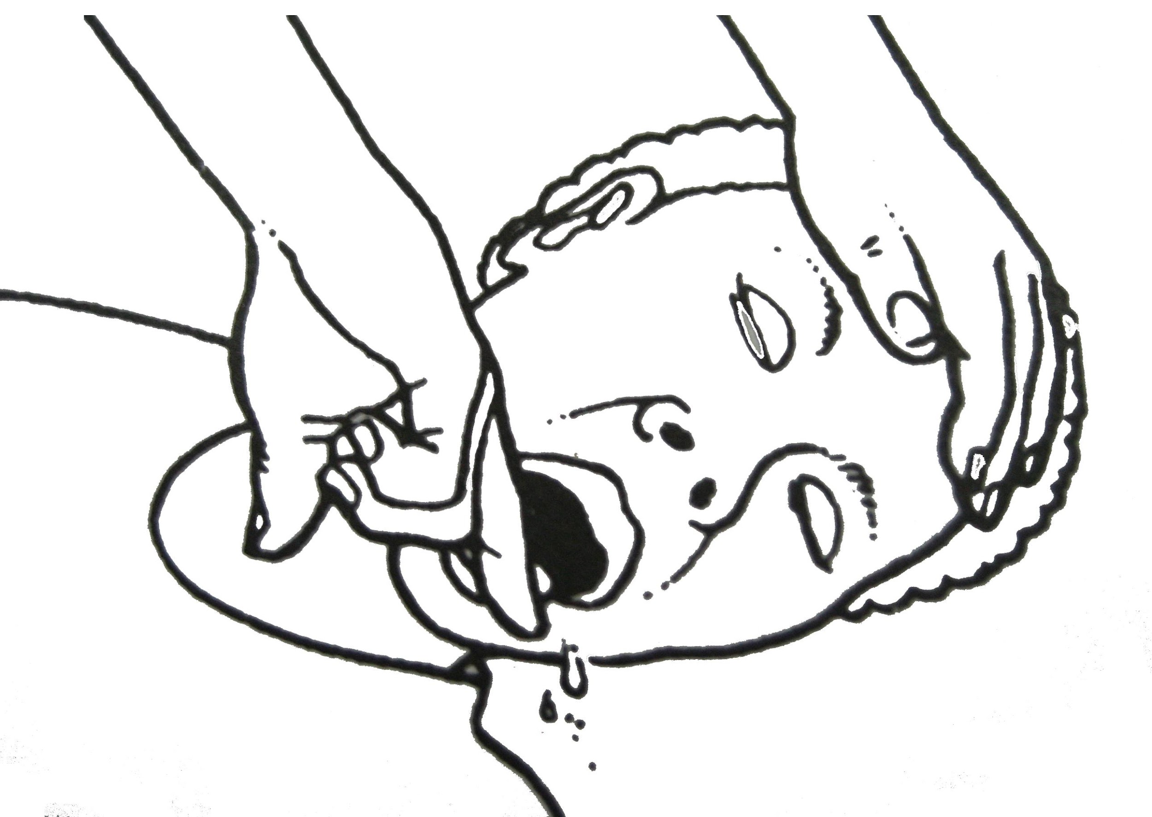
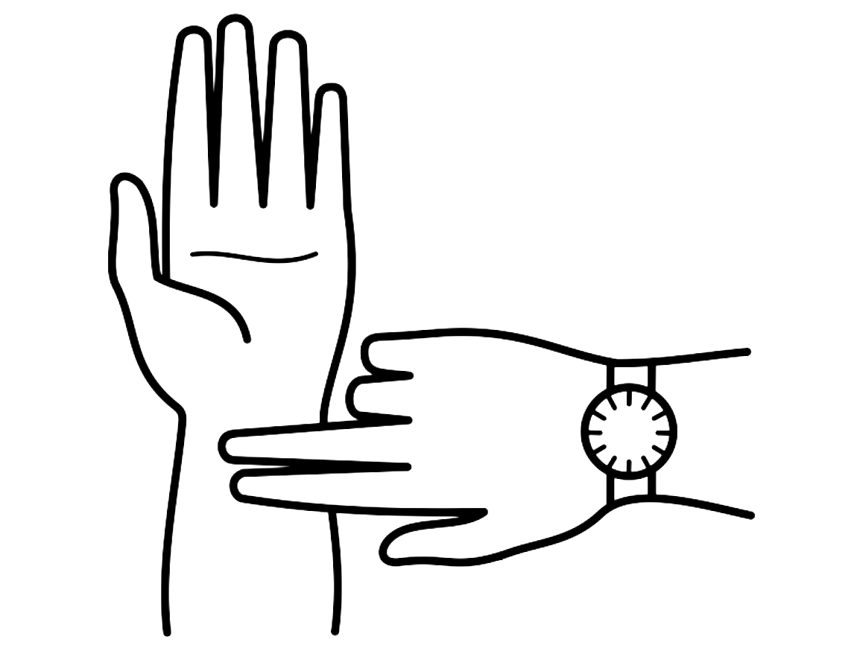
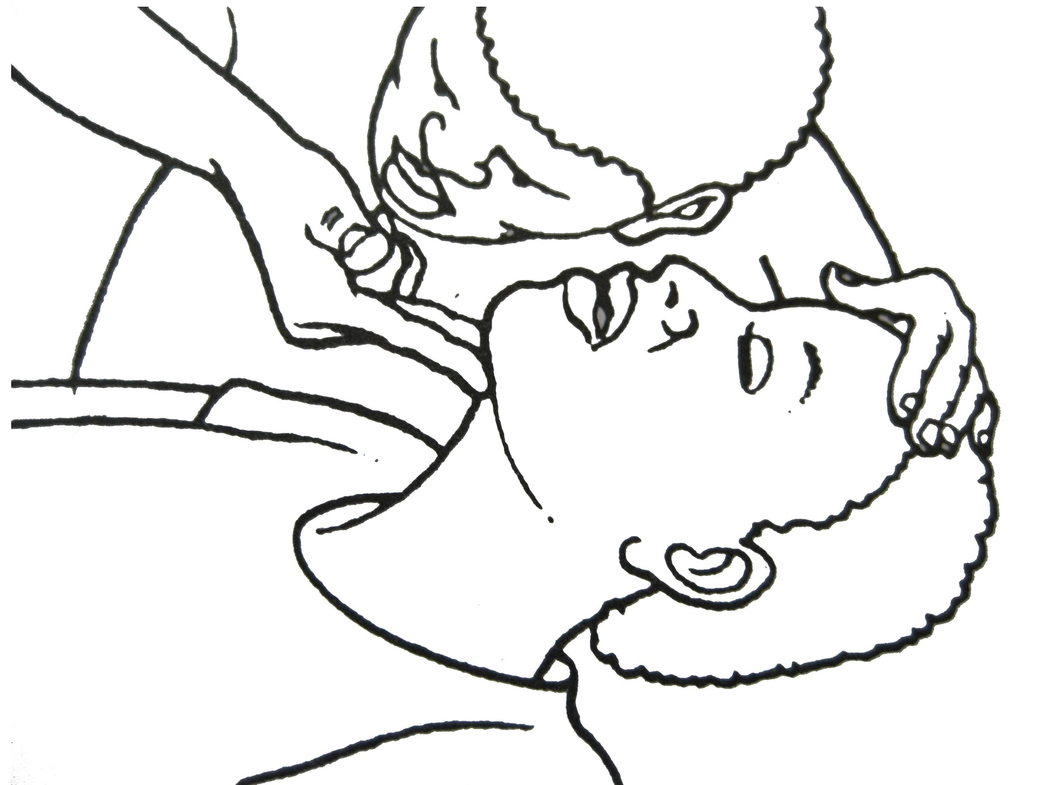
3) ABC’s
Airway
Breathing
Circulation

Slide 11
Airway
Without an open airway, patients can die within minutes
In the case the victim does not respond:
Open the airway – Head tilt chin lift
Clear nose and mouth
Lift chin- This lifts the tongue from the throat
DO NOT SHOVE YOUR FINGERS IN THE PATIENT'S MOUTH
Notes:
Have each participate demonstrate difficulty breathing with neck/chin flexed vs. extended
Discuss significance of patient being able to talk with regard to patent airway and breathing

Slide 12
Breathing
Look, Listen, and Feel
If patient is not breathing, bring him or her to the Hospital immediately!
Notes:
Look (for chest rise and fall)
Listen (for snoring or clear breathing sounds)
If patient is not breathing, bring him or her to the Hospital immediately!
Have each participate demonstrate difficulty breathing with neck/chin flexed vs. extended
Discuss significance of patient being able to talk with regard to patent airway and breathing

Slide 13
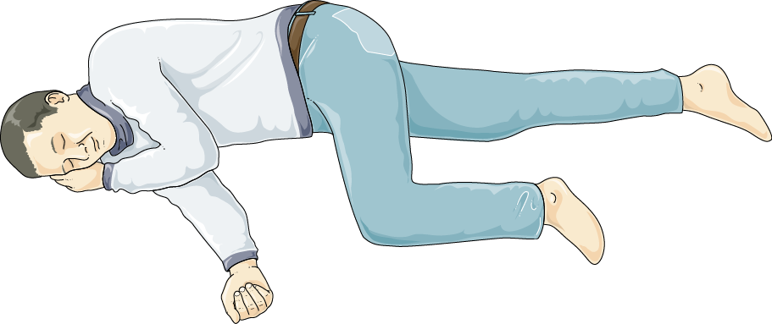
Recovery Position
If the patient is unconscious or after convulsions
Stabilize the neck
Roll the patient onto side
This will allow any fluids blocking the patient’s airway to drain
Notes:
If the patient is unconscious
While stabilizing the neck
Roll the patient onto side (“Recovery Position”)
This will allow any fluids blocking the patient’s airway to drain

Slide 14
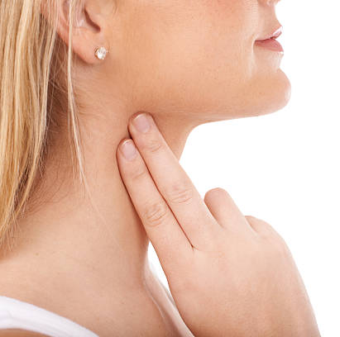
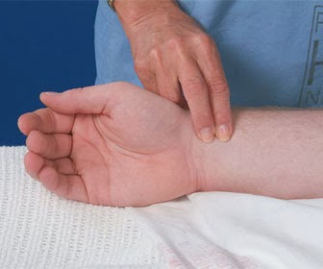
Circulation- Pulse
Carotid Pulse: gently place two fingers on the side of the neck, above the collar bone of the patient and feel for a pulse.
Radial Pulse: gently place two fingers on the inside of the wrist of the patient and feel for a pulse. (THIS MAY BE VERY LIGHT)
Notes:
One way to assess circulation is by taking your patients pulse
Here are two ways to look for a pulse
NO PULSE DOES NOT MEAN THE PATIENT IS DEAD

Slide 15
3) ABCs
Skills Station Practice!
Open airway using head-tilt chin lift method
Check for breathing
Check for pulse
Recovery Position
Notes:
Breakout session with partner

Slide 16
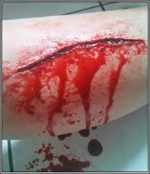
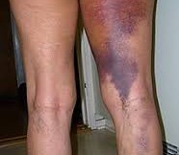
External Bleeding VS Internal Bleeding

Slide 17
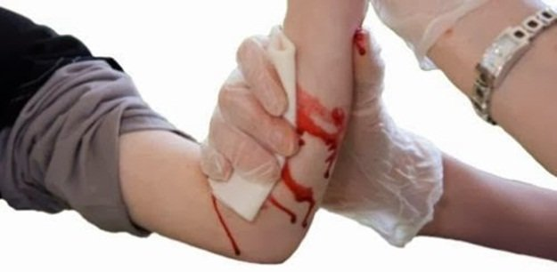
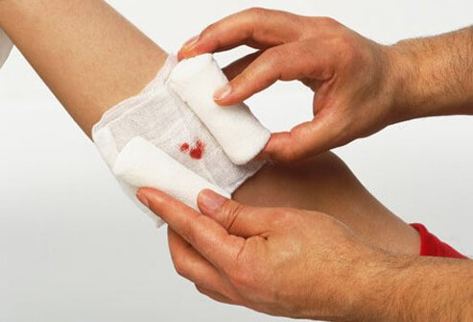
Circulation- Bleeding Treatment
A victim with severe bleeding can die in minutes or less without your help
Apply gauze quickly with firm direct pressure
Wrap the wound with a bandage
Maintain pressure
Elevate limb
If bleeding is still not under control, add another pad/bandage to the affected area,
NEVER REMOVE EXISTING PADS

Slide 18
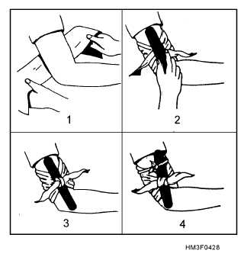
Circulation- Tourniquetting
Tourniquets are used to stop blood loss from a bleeding extremity if the bleeding does not stop using bandages
Place a fabric tie above the bleeding area
Wrap the cloth around the limb and cross the ends and place a stick or rod in-between the loose ends
Tie the ends and twist the stick tight until the bleeding stops
Tie the stick in place with another cloth or string
Write the Time of application on the patients forehead

Slide 19
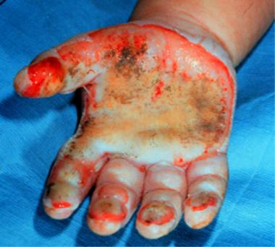
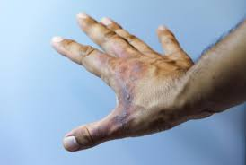
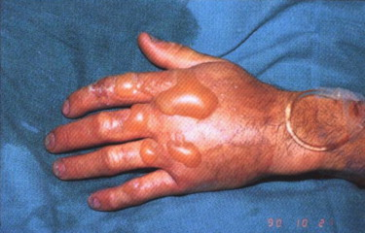
Circulation- Burns
First, assess the severity of the burn
1st Degree (Color) 2nd Degree (Blisters) 3rd Degree (Flesh)
Then, treat the Burn with Dry Gauze
DO NOT BURST ANY BLISTERS
DO NOT USE OINTMENTS OR CREAMS

Slide 20
3) ABC’s
Skills Station Practice!
Attend to severe bleeding from the forearm with gauze, pressure and elevation
Tourniquet the bleeding extremity

Slide 21
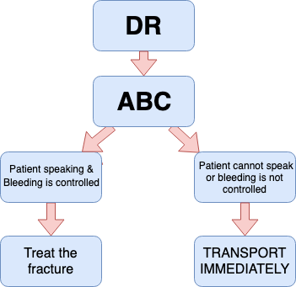
Course Review
Principles and definitions
Scene Safety (DR.)
ABCs
Fracture Splinting
Managing Multiple Victims
Victim Transport

Slide 22
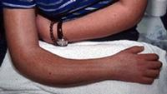
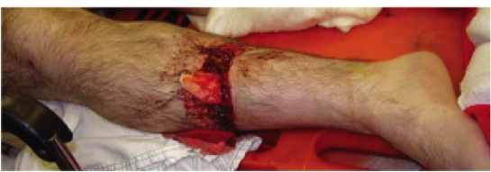
4) Fracture Splinting
A wound which occurs on a bone, in the form of cracking, breaking, or sticking out of the body
Fractured bone Open fracture

Slide 23
4) Fracture Splinting
Symptoms of a Fracture:
Swollen
Black and blue
Very painful when touched or moved
Change in form
Examples:
Pelvis fracture: trouble walking, can loose up to 5L of blood
Back fracture: Change in posture
Femur fracture: thigh pain
Notes:
Change in form = change how the limb should look

Slide 24
4) Fracture Splinting
Move the limb as little as possible
Use wooden splinting boards to and fabric ties
Cover open fractures with clean, wet gauze
Notes:
Move the limb as little as possible – fixation is the goal (immobilization of bone)
Use wooden splinting boards to and fabric ties to keep the limb clean, still, and stable
Open fractures should be covered with clean, wet gauze

Slide 25
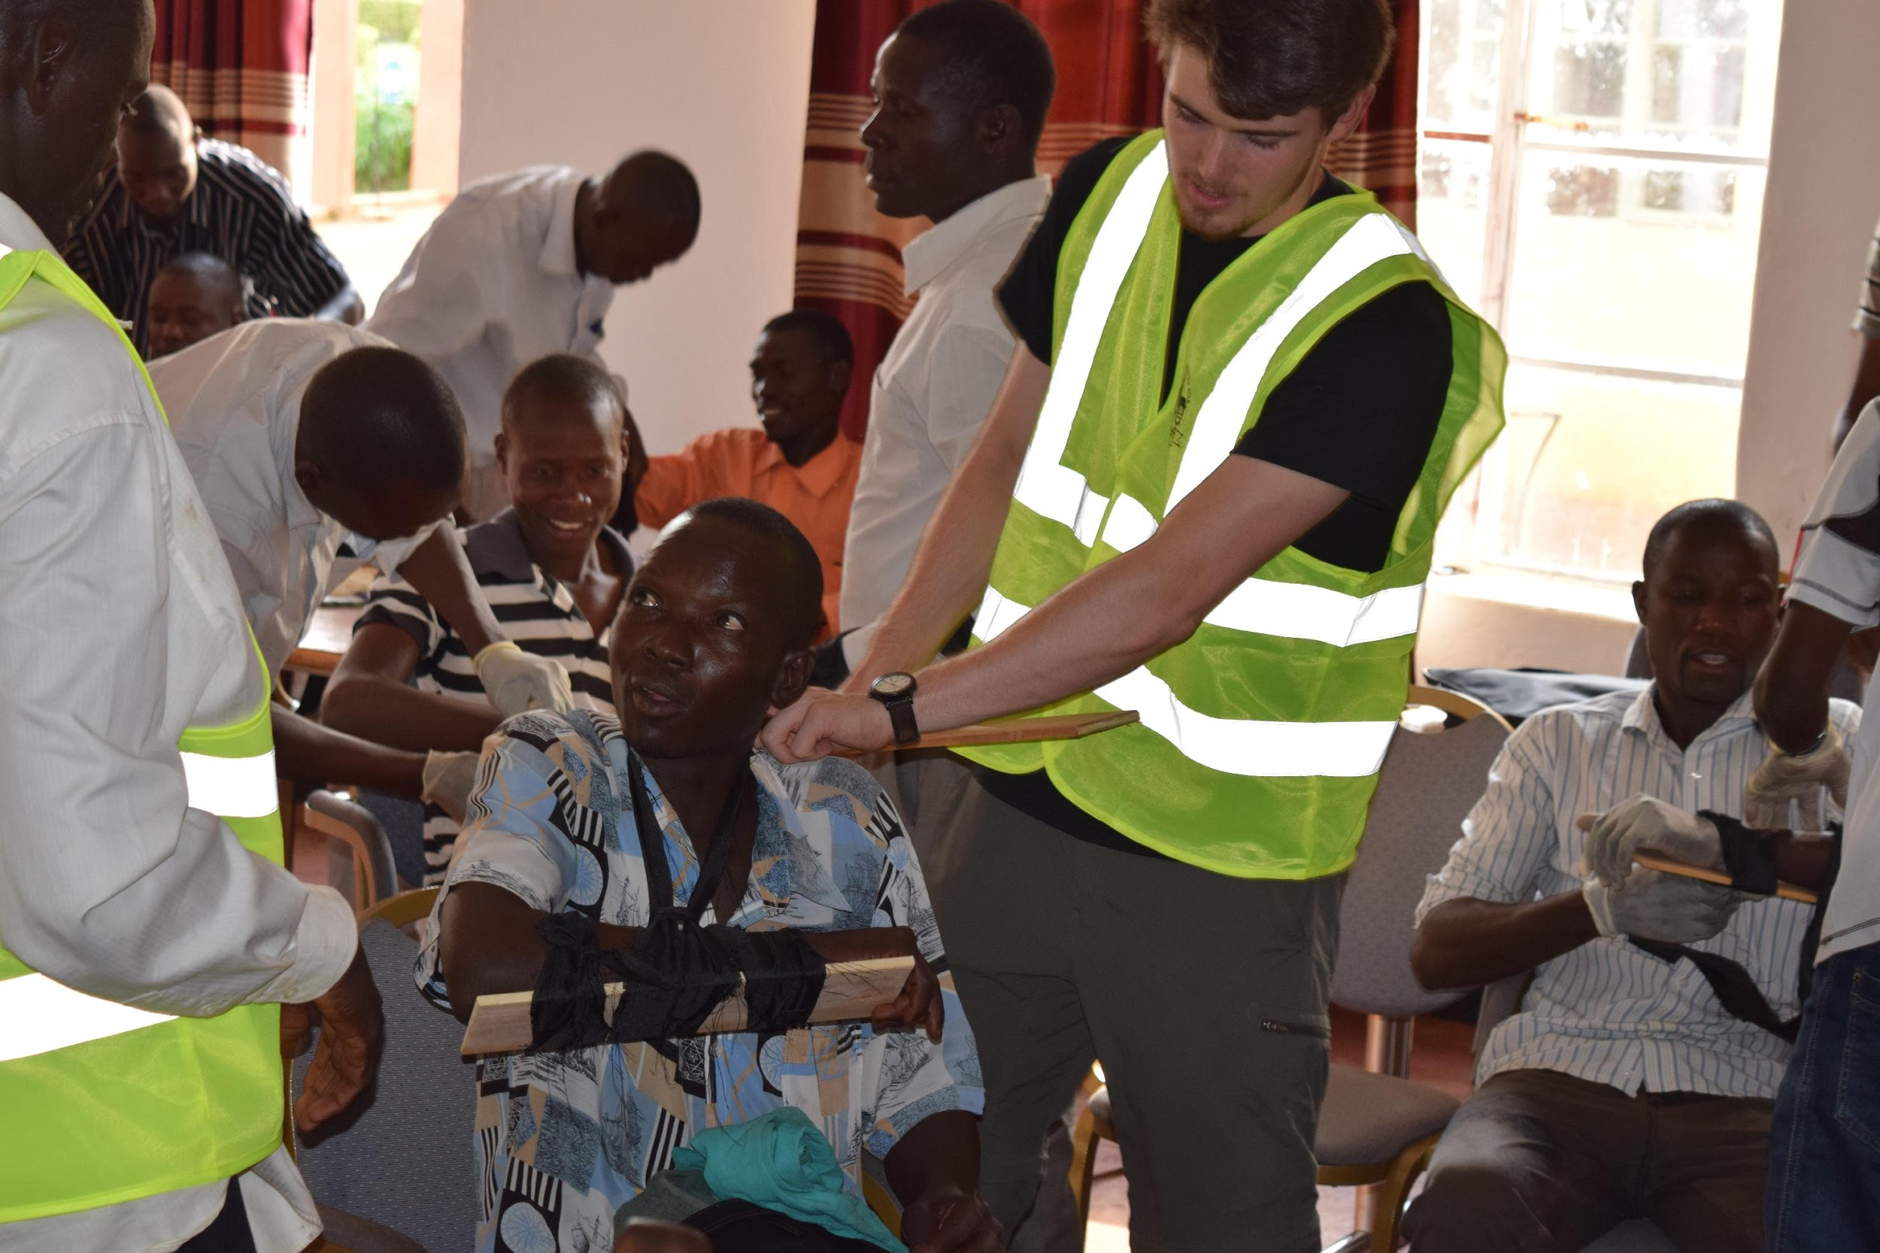
4) Fracture Splinting
Do not try to restore the broken bone back to its original position
Do not delay transport to the hospital for fracture splint
Skills Station Practice!
Broken arm and leg (use board and fabric ties)
Notes:
Do not try to restore the broken bone back to its original position by pressing, pulling, or reinserting the bone
If you are having difficulty splinting or the patient has multiple injuries, do not delay transport to the hospital for fracture splint

Slide 26
5) Managing Multiple Victims
Assess number and severity
Attend to the most severe first (triage)
Immediate
Delayed
Minimal
Expectant (to die)
TREAT FIRST
Unconscious
Bleeding
Has pulse
Difficulty breathing
TREAT SECOND
Conscious
Bleeding
Broken limbs
Cannot move themselves
TREAT LAST
Walking
Talking
Superficial wounds
DO NOT TREAT
No breathing AND
No pulse
Notes:
Don’t run to the loudest victim
Unconscious victims first
Shout or rub victim to assess
Look for those that you can treat easily, do not treat those who are past help
Better to save more than just one

Slide 27
Course Review
Principles and definitions
Scene Safety (DR)
ABCs
Fracture Splinting
Managing Multiple Victims
Victim Transport

Slide 28
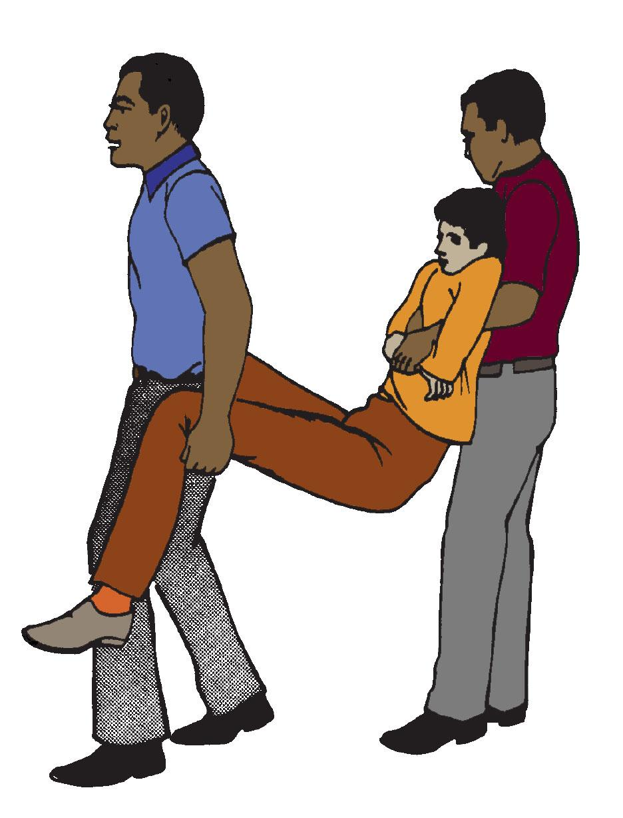
6) Victim Transport
Once you have assessed:
Danger, Response → Airway, Breathing, and Circulation
Now, time for transport:
Move
Stabilize

Slide 29
6) Victim Transport - (Stabilize)
Broken bones can cause harm to a victim in transport, especially a broken neck
If you think the head or neck could have been injured, immobilize movement of the neck using your towel
Having an open airway is much more important than not moving the neck
Keep neck secure

Slide 30
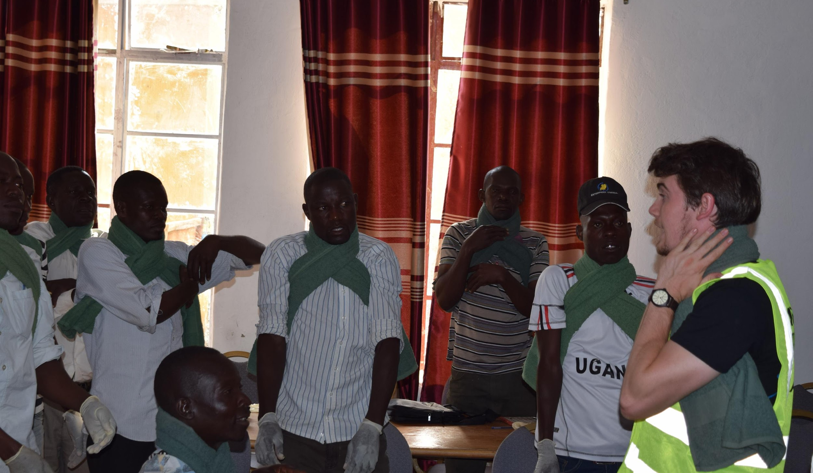
Neck Immobilization
Fold towel long way to the width of the neck
From behind, rap towel evenly around neck
Pull ends through under the arms, ensuring airway stays secure

Slide 31
6) Victim Transport - (Move)
If possible, get others to help and maintain control of the neck
Drive the victim at a reasonable speed
Practice moving victims from scene onto motorcycle and securing
Victim must be kept upright
(IF MULTIPLE EXTREMITY INJURIES, WAIT FOR ALTERNATIVE TRANSPORT)
Notes:
Once again, if possible, get others to help and maintain control of the neck
If supine, place victim onto tarp by log-rolling
Drive the victim at a reasonable speed
Speed may cause more harm to the patient
Will likely not make a difference in transport time, and you will have a higher chance yourself of becoming a victim
Practice moving victims from scene onto motorcycle and securing
Victim must be kept upright
(IF MULTIPLE EXTREMITY INJURIES, WAIT FOR ALTERNATIVE TRANSPORT)

Slide 32
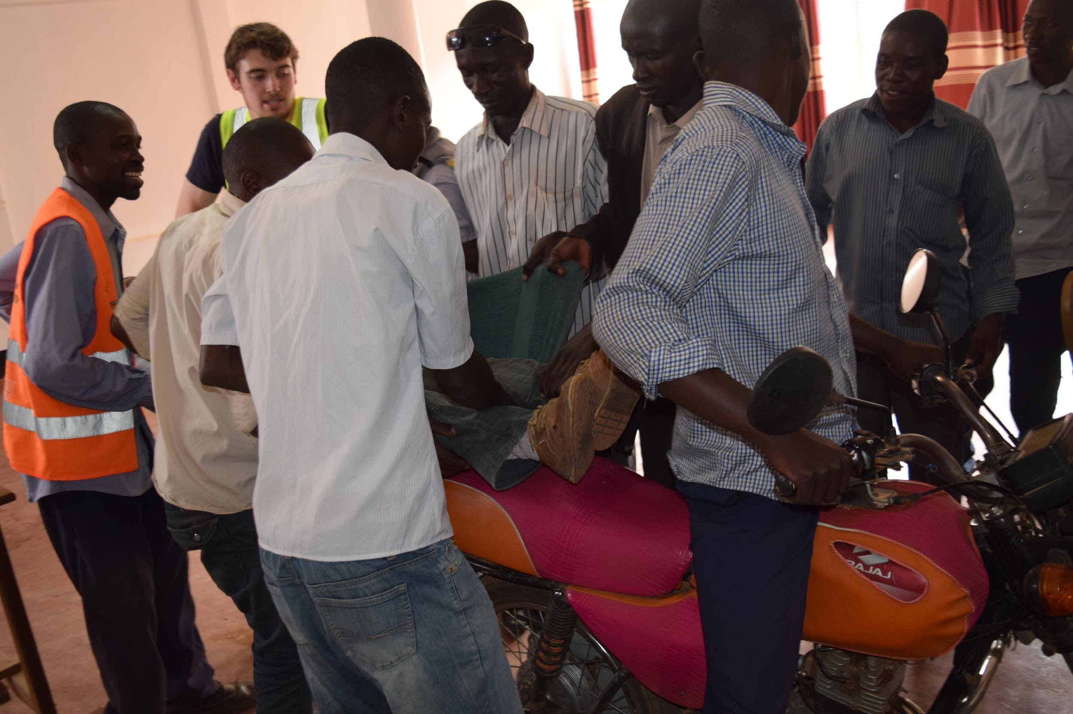
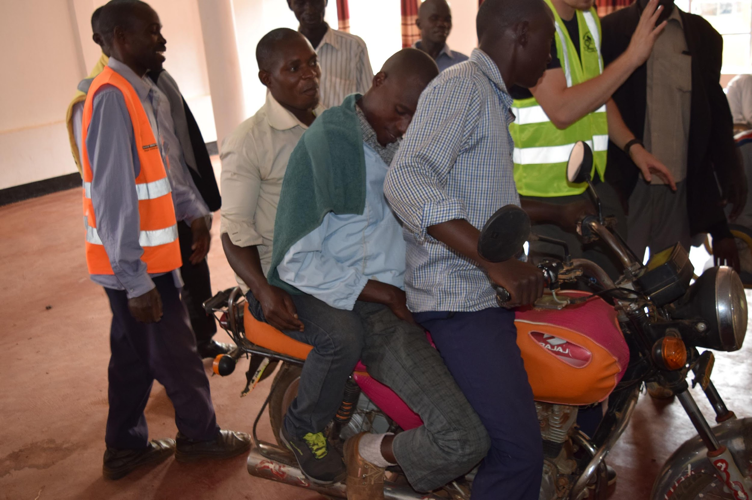
6) Victim Transport
Bystander/
First Aider
Victim
Driver
Notes:
Seat the driver
Position the victim, spread legs and place onto seat behind rider
First Aider at victim’s head follow onto seat behind victim
- Just use the reverse order when removing victim from the motorcycle

Slide 33
What transport should I use?
Indications | Contraindications
Alert (can protect their own airway | Unconscious
Controlled bleeding | Uncontrolled bleeding
Single Extremity fracture | Multiple extremity fractures
Neck immobilization | Back or pelvis fracture
USE A MOTORCYCLE
USE A MOTORCAR/AMBULANCE

Slide 34
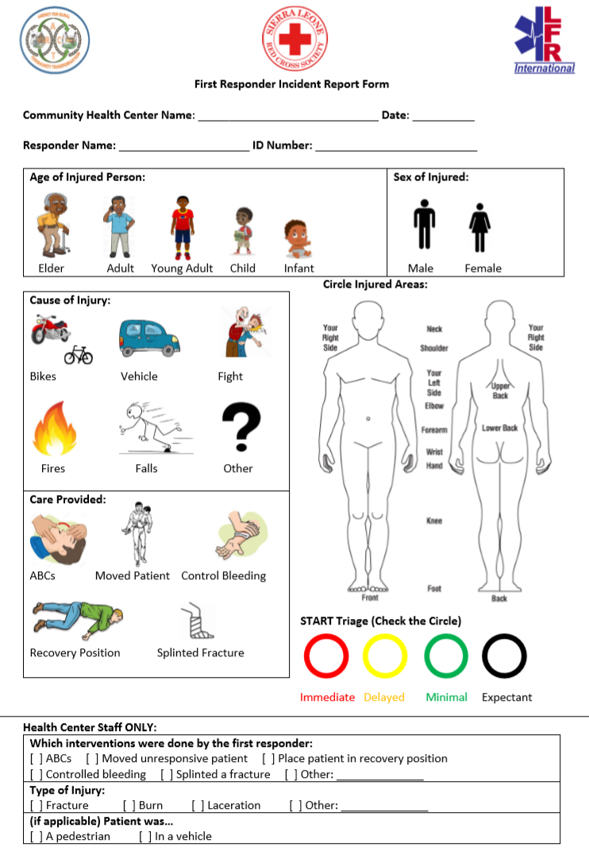
Review Data Form
Age
Sex
Cause of Injury
Care Provided
Area Of Injury
Injury Severity
DO NOT DRIVE AS FAST AS YOU CAN on the way. Drive at a REASONABLE SPEED.
Notes:
Forms will be available at all Community Health Centers and Hospitals and chiefdom headquarters
Once you have transported a patient, please fill out and turn in the form.
It is very important to fill out the form so we can make this training better
You don’t have to take the patient to hospital if their injury is not severe and if they ask you not to

